Slide 1

CAPSTONE PROJECT
Loan Defaulter
Prediction
Submitted By:
Rishabh Tiwari
Sanjay Sarkar
Victor Ravindra
Yogesh Thakare
Batch: PGA-06
Feb 2021

Slide 2
Problem Summery
This data is of XYZ Corp for period of 2007-2015.
We must think like a loan issuer and manage credit risk by using the past data and deciding whom to give the loan to in the future
There are 855969 records with 73 features.

Slide 3
Agenda
Importing dataset
EDA
Feature Engineering
Splitting x_train,y_train, x_test and y_test
Feature Scaling
Machine Learning Algorithms
Evaluation Metrics
Deep Learning Algorithms
Evaluation Metrics
Conclusion

Slide 4
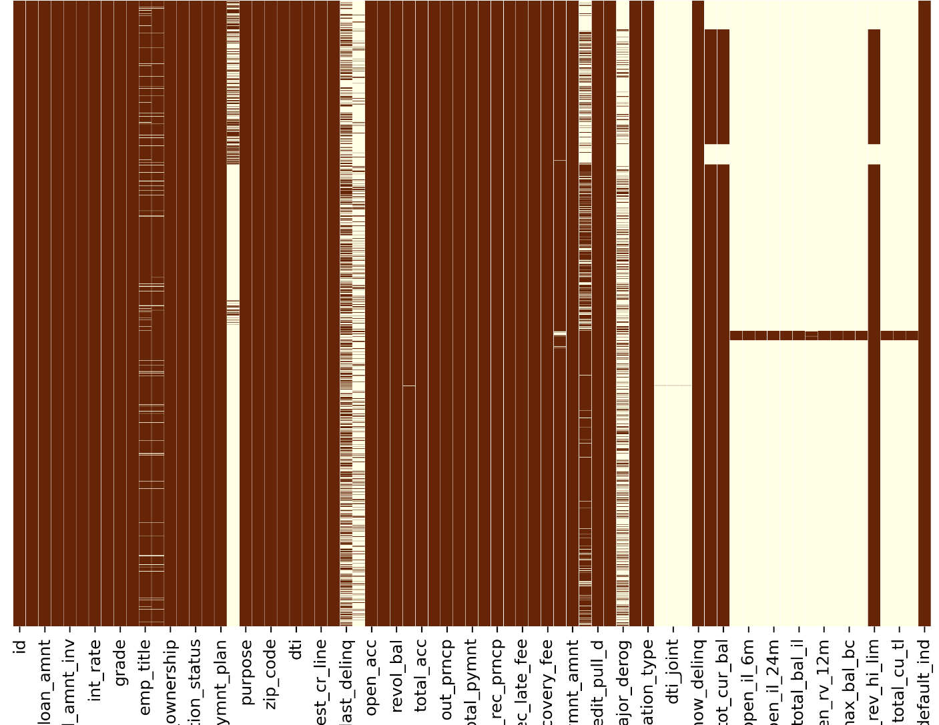
Exploratory Data Analysis (EDA) Data Cleaning
Checking missing values(Data Cleaning)
Displaying the missing values

Slide 5
Exploratory Data Analysis (EDA) Checking for duplicate records
After running the code to detect duplicates.
Output: False 855969
dtype: int64
Note: there are no duplicate records in the data

Slide 6
Exploratory Data Analysis (EDA) Segregating categorical variable
['term', 'grade', 'sub_grade', 'emp_title', 'emp_length', 'home_ownership', 'verification_status', 'issue_d', 'pymnt_plan', 'purpose', 'title', 'zip_code', 'addr_state', 'earliest_cr_line', 'initial_list_status', 'last_pymnt_d', 'next_pymnt_d', 'last_credit_pull_d', 'application_type']

Slide 7
Exploratory Data Analysis (EDA) Segregating numerical variables
['id', 'member_id', 'loan_amnt', 'funded_amnt', 'funded_amnt_inv', 'int_rate', 'installment', 'annual_inc', 'dti', 'delinq_2yrs', 'inq_last_6mths', 'open_acc', 'pub_rec', 'revol_bal', 'revol_util', 'total_acc', 'out_prncp', 'out_prncp_inv', 'total_pymnt', 'total_pymnt_inv', 'total_rec_prncp', 'total_rec_int', 'total_rec_late_fee', 'recoveries', 'collection_recovery_fee', 'last_pymnt_amnt', 'collections_12_mths_ex_med', 'policy_code', 'acc_now_delinq', 'tot_coll_amt', 'tot_cur_bal', 'total_rev_hi_lim', 'default_ind']

Slide 8
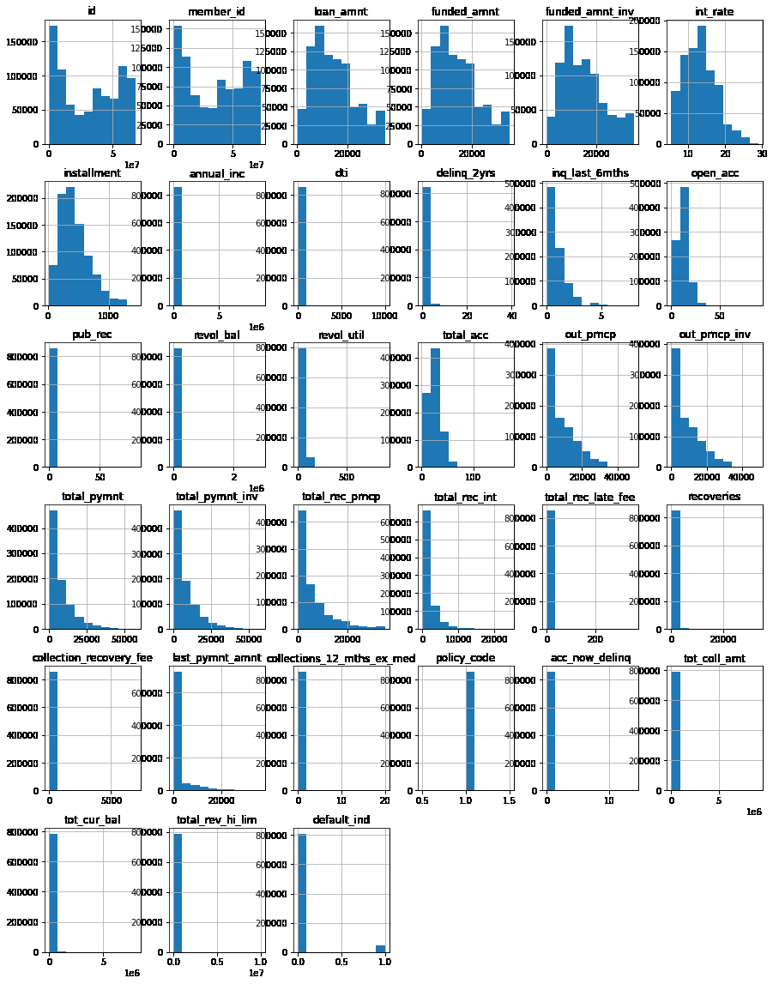
Plotting histogram of all features(A)

Slide 9
Plotting histogram of all features(B)

Slide 10
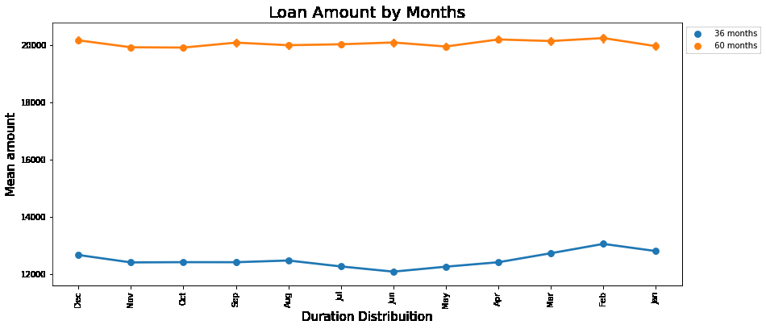
Loan Amount by Months and term
By this graph we understand that the amount of Loan is usually higher for longer duration of the said Loan.

Slide 11
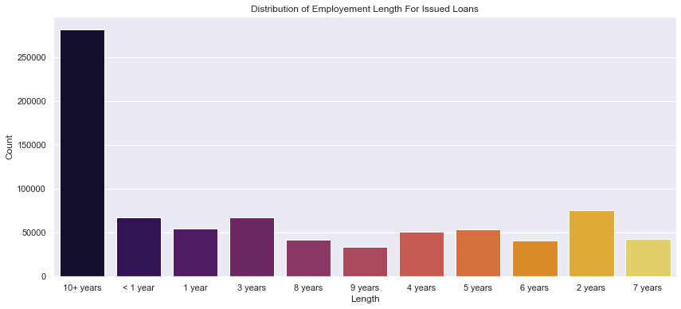
Bar plot on emp_length
Here we can assume that Loans are given to those whose employment duration is longer.

Slide 12
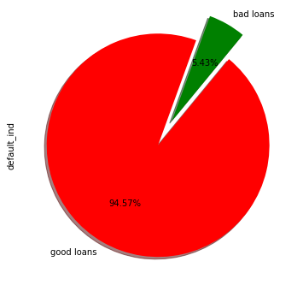
Pie Cart on Default_ind
The distribution of Good loan is higher compared to bad loans

Slide 13
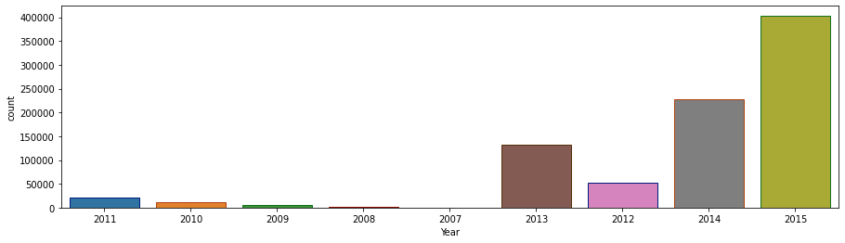
Distribution cases according to the Year of Loan issued
This is derived from the “issue_date” and bifurcated accordingly.

Slide 14
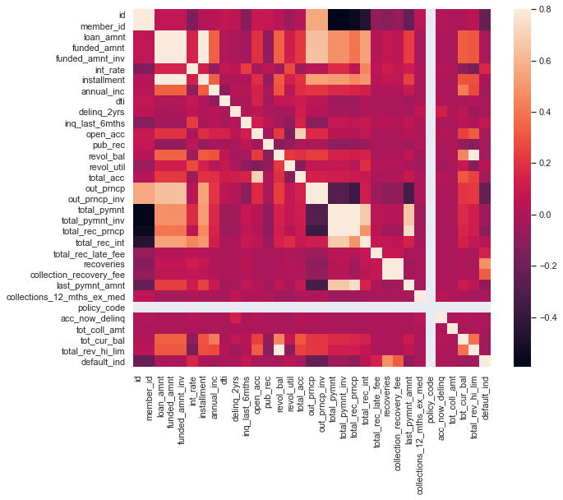
correlation matrix

Slide 15
Exploratory Data Analysis (EDA)
Resolving missing data(cont)
As the number of features were high, we decided to reduce variable based on significant missing data.
A table was created to count the number of missing values and find the percent of those missing values.
Any feature that had more than 50% data missing where dropped.

Slide 16
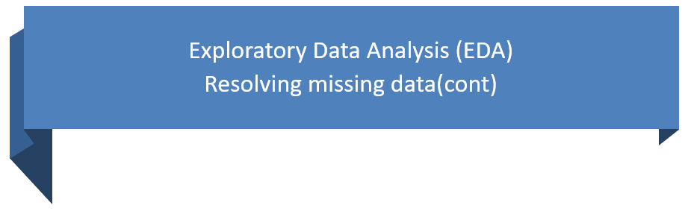
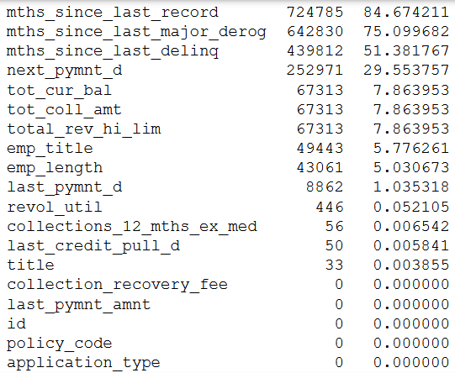
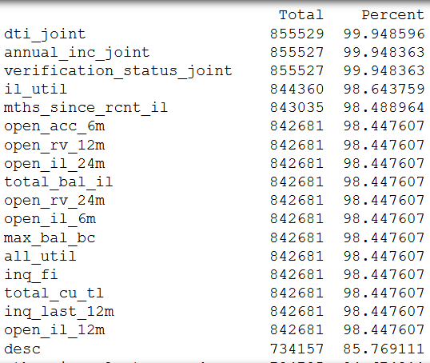
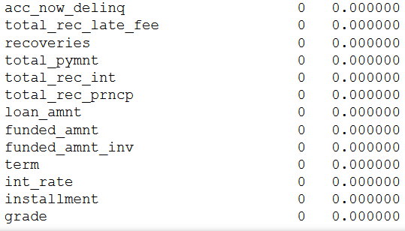

Slide 17
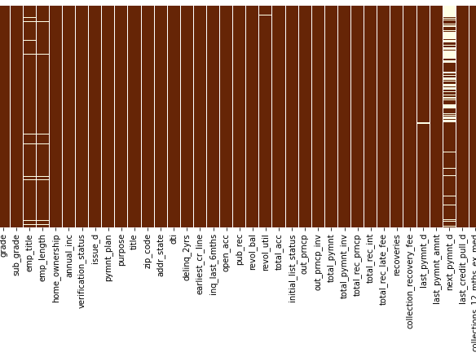
Updated feature list with
fewer missing values

Slide 18
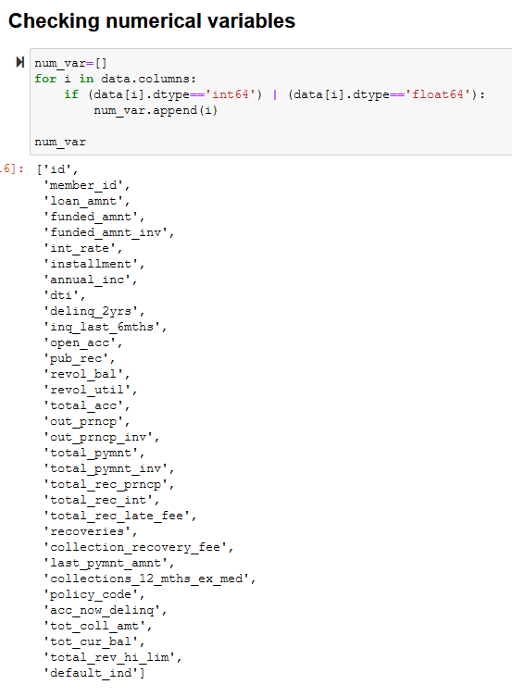
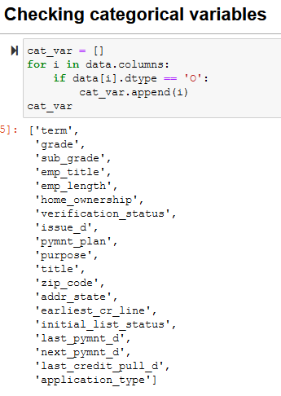
Filtered
Categorial
and
Numerical Variables

Slide 19
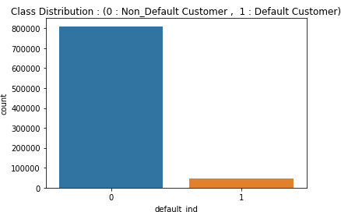
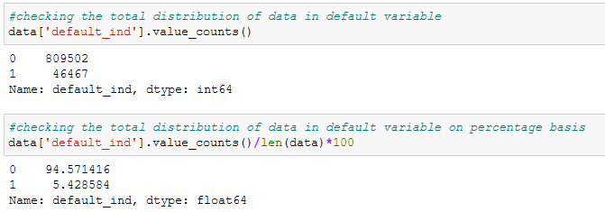
Information on default_ind variable
% distribution
Total count

Slide 20
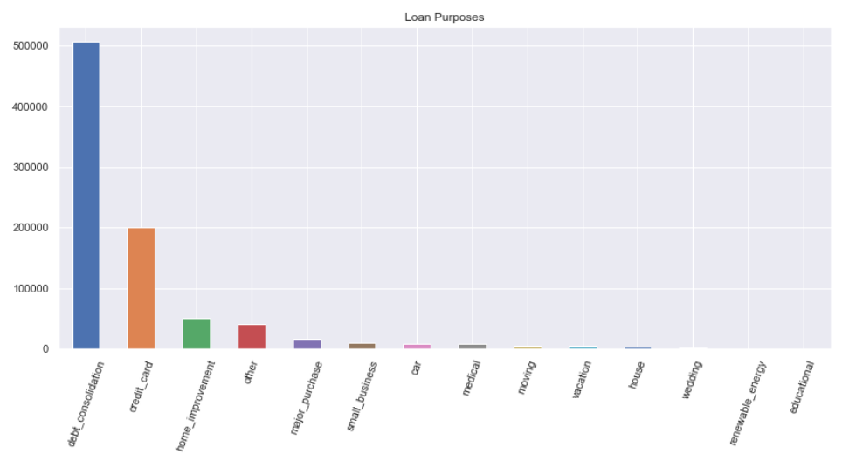
Information on Purpose of Loan
We can assume that most Loans are taken according to necessity of the customer

Slide 21
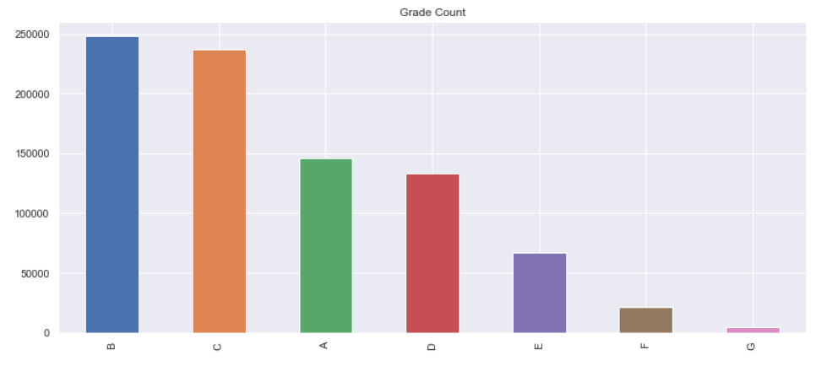
Information on distribution of
Loan Grade
Loan Grade B and C are more favoured

Slide 22
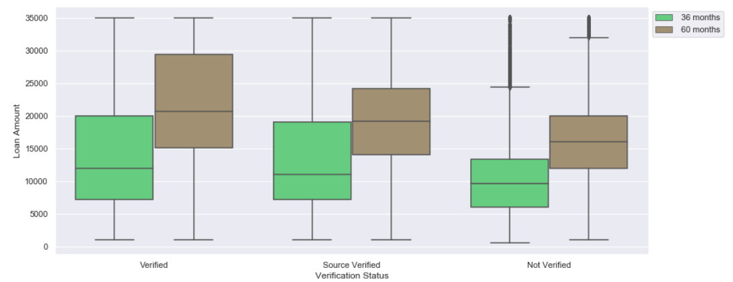
Plot showing Loan amount
by verification status
Loan Grade B and C are more favoured

Slide 23
Feature Selection:
Variables that are being removed based on domain knowledge
policy_code is always 1
payment_plan has only 10 y and 887372 n
id and member_id are all unique, which is a bit misleading. So, every record is a unique customer
application_type is 'INDIVIDUAL' for 99.94% of the records
acc_now_delinq is 0 for 99.5% of the records
emp_title not needed here, because it's a categorical variable with (290912 level)
zip_code not needed for this level of analysis,
title can be removed as well because it's a categorical variable with (61000 level).
earliest_cr_line variable because it's a date variable with (697 level)
addr_state variable has 51 level
next_pymnt_d variable because it's a date variable with (3 level) and it contains 29% Missing info.
last_pymnt_d variable because it's a date variable with (51 level)
last_credit_pull_d variable because it's a date variable with (102 level)
sub_grade because it has 35 levels

Slide 24
Imputing Missing data
To simplify our imputation, we have replaced the missing categorical variables with mode values
and
numerical variables with mean values

Slide 25
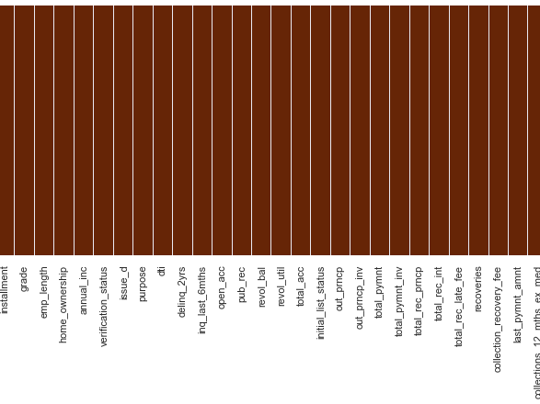
No more missing data

Slide 26
Handling Categorical Variable
We tried two techniques
Manual Encoding
Label Encoding

Slide 27
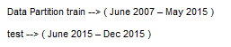
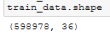
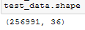
Splitting the data into Training data and Testing data
Performing
Feature
Scaling
Creating
x_train, y_train,
x_test, y_test
For feature scaling we used StandardScaler from Sklearn Library

Slide 28
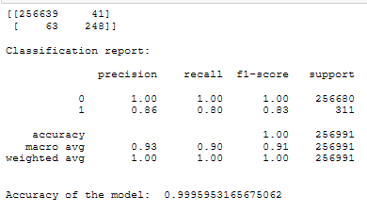
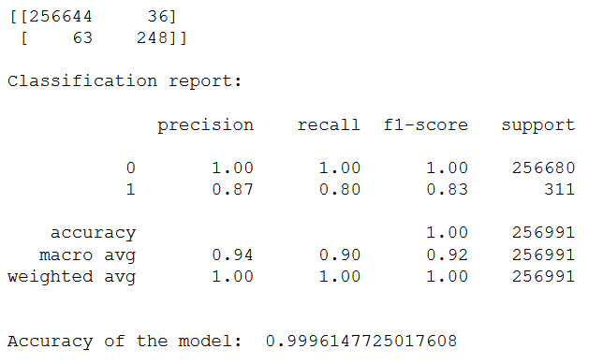
Logistic Regression
Obervation:
# type 2 error : 63 ,
# type 1 error: 41
Tried tunning the model by adusting the threshold level for probabilities
After tunning
Not much changed

Slide 29
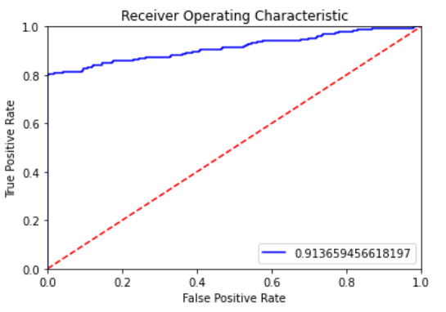
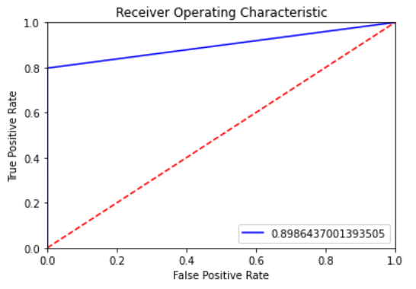
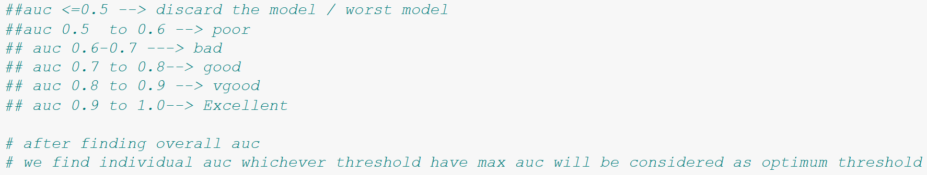
AUC-ROC
As we were confused between multiple thresholds, we tried uses AUC-ROC for optimum threshold
Accuracy: 0.8986437001393505
FPR: 0.00000000e+00, 1.40252454e-04, 1.00000000e+00
TPR: 0., 0.79742765, 1.,

Slide 30
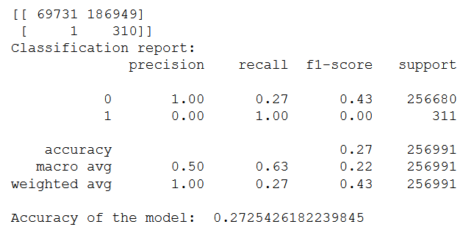
Decision Tree
Obervation: We have a significant Type 1 Error

Slide 31
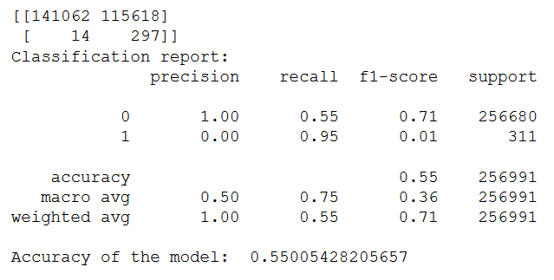
Bagging Technique
ExtraTreesClassifier
Obervation: We have a significant Type 1 Error

Slide 32
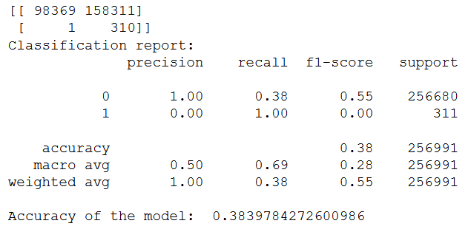
Random Forest Classifier
Obervation:
We have a significant Type 1 Error

Slide 33
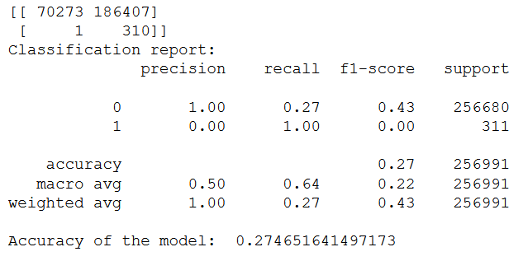
Boosting Technique
AdaBoost Classifier
Obervation: We have a significant Type 1 Error

Slide 34
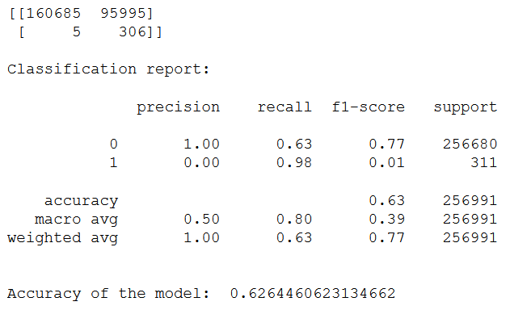
Gradient Boosting Classifier
Obervation: We have a significant Type 1 Error

Slide 35
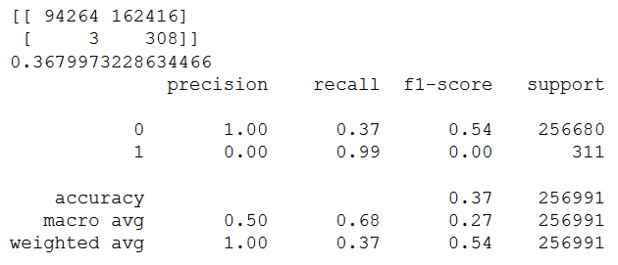
XGBOOST Classifier
Obervation: We have a significant Type 1 Error

Slide 36
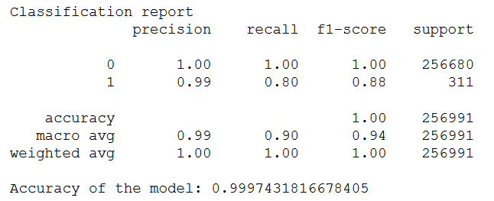
ANN using Keras Library
Obervation: We have a significant Type 1 Error

Slide 37
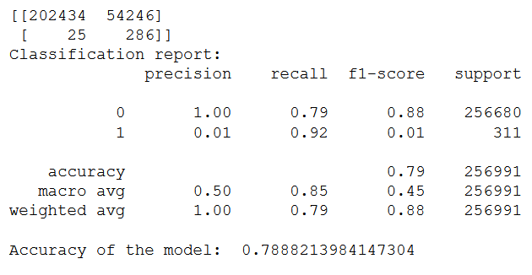
ANN using MLP classifier
Obervation: We have a significant Type 1 Error

Slide 38
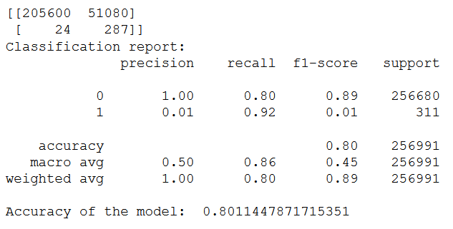
Ensemble models Using
Voting classifier
Obervation: We have a significant Type 1 Error
LogisticRegression
GradientBoostingClassifier
MLPClassifier

Slide 39
Feature Selection
using
mutual_info_classif
SelectKBest

Slide 40
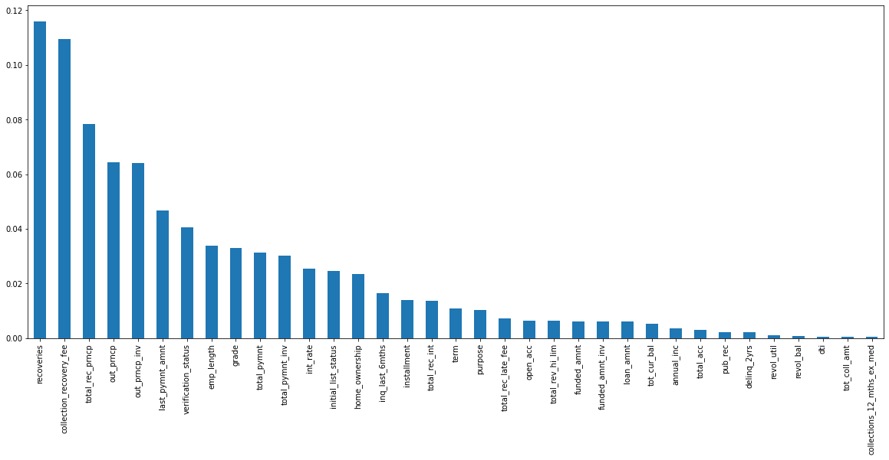
Feature Selection using
mutual_info_classif

Slide 41
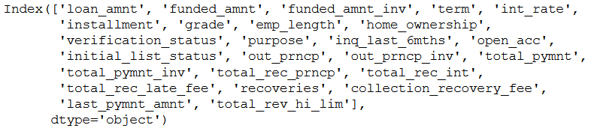
Based on mutual_info_classif
SelectKBest for Top 25 Variables

Slide 42
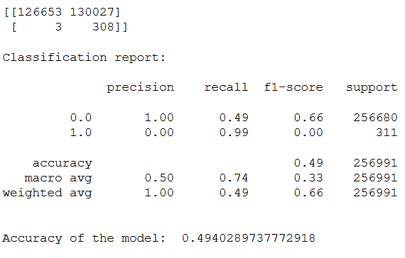
Gradient Boosting Classifier
After Feature selection
Obervation: We still have a significant Type 1 Error

Slide 43
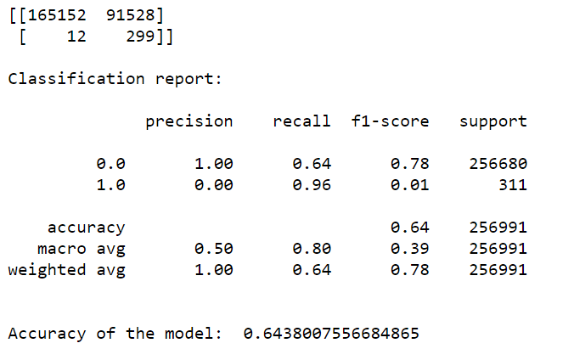
Handling Imbalance Dataset
SMOTE- Gradient Boosting Classifier
Obervation: We still have a significant Type 1 Error

Slide 44
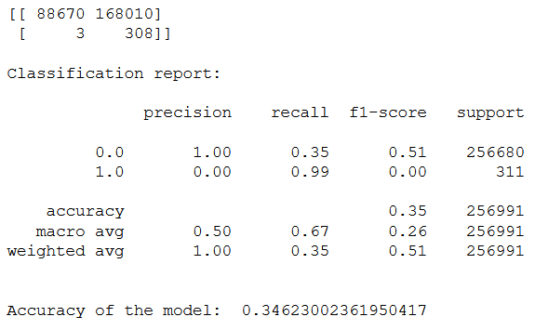
Handling Imbalance Dataset
SMOTE- XGBClassifier
Obervation: We still have a significant Type 1 Error

Slide 45
Trying out new feature selection
to decrease the type-1 error
Creating another dataframe with new variables.
Previously we had 36 variables.
In new dataset we added total 39 variables after feature selection.
Based on the missing value criteria not more than 50% and using “feature importance” method to determine insignificant variables which to be opted out on basis of domain knowledge and considering the best variables suitable to fit the model best to get better accuracy.
We dropped:
'id','member_id','funded_amnt_inv','grade','emp_title','pymnt_plan','desc','title','addr_state', 'inq_last_6mths','mths_since_last_record','initial_list_status','mths_since_last_major_derog’,
'policy_code','dti_joint','verification_status_joint','tot_coll_amt','tot_cur_bal','open_acc_6m','open_il_6m','open_il_12m','open_il_24m','mths_since_rcnt_il','total_bal_il','il_util','open_rv_12m','open_rv_24m', 'max_bal_bc','all_util','inq_fi','total_cu_tl','inq_last_12m','annual_inc_joint'

Slide 46
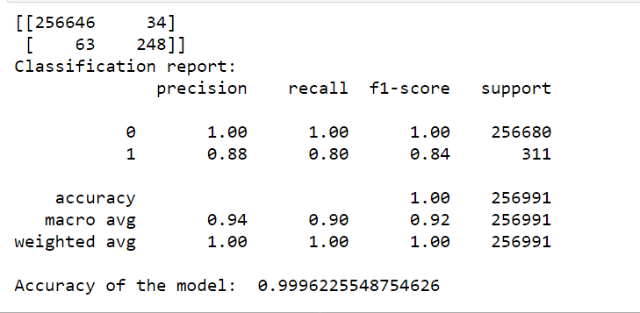
Prediction on new variables:
Logistic Regression on New Dataset.

Slide 47
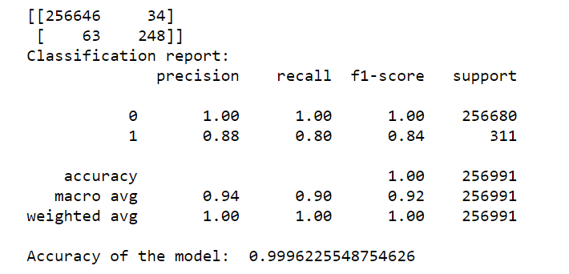
After Tuning the Model from
threshold value 0.4 to 0.6

Slide 48
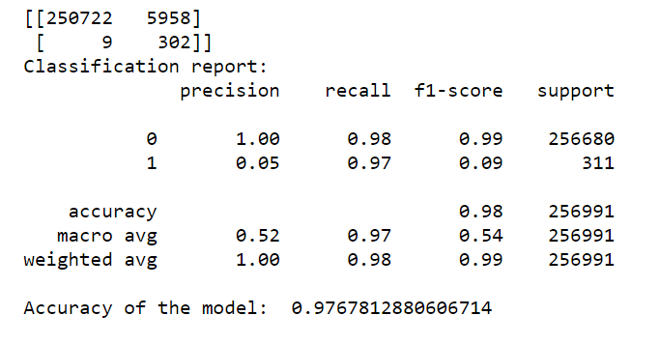
Decision Tree Classification on New Dataset.

Slide 49
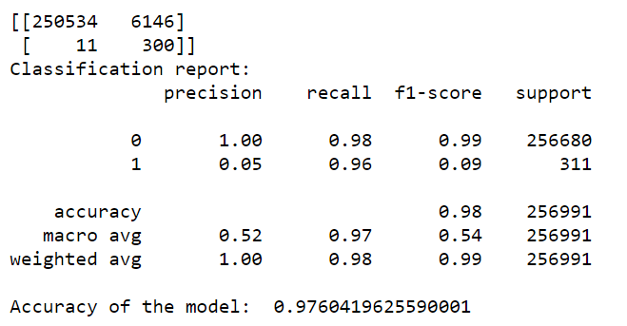
ExtraTreesClassifier

Slide 50
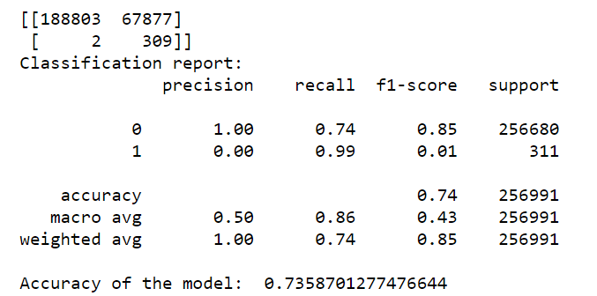
Random Forest Classifier

Slide 51
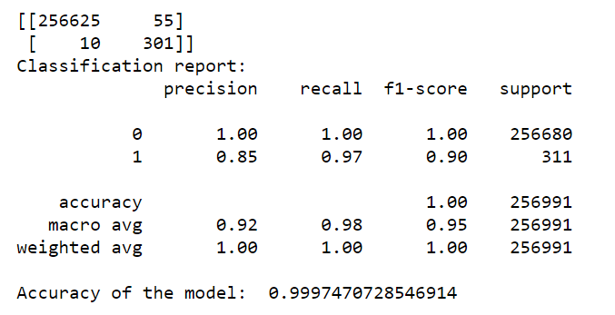
Gradient Boosting Classifier.

Slide 52
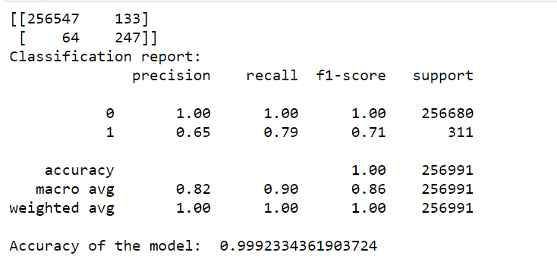
ANN Using MLP Classifier

Slide 53
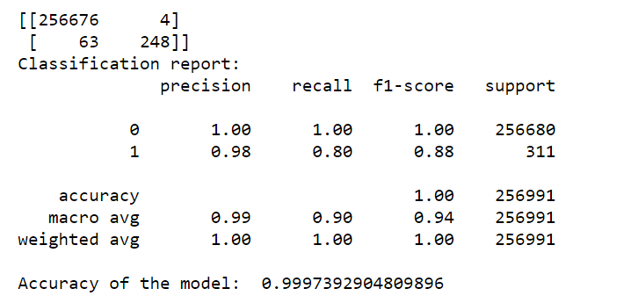
ANN using keras libraries

Slide 54
Final Model:
Gradient Boosting Classifier. (With Tuning)

Slide 55

Final Prediction:
After comparing various models, the gradient boosting classifier (with tuning) is the best model so far.
Prediction on the whole dataset.

Slide 56

Conclusion:
The results of Neural Network with Keras and Gradient Boosting were the best among all algorithm.
If you want low type 1 error, use Neural Network.
If you want low type 2 error, use Gradient Boosting.
Type 2 error are actual losses for the company and type 1 error are failed profit.
As type 2 error is unsuitable for company leading to loss in our case, we preferred using Gradient Boosting.

Slide 57


THANK YOU

